Slide 1
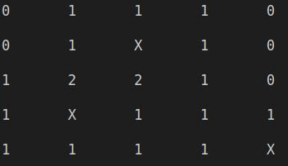
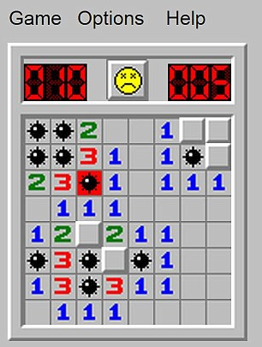
Minesweeper
By: Trey Pollock
The purpose is to reveal all numbers on the grid without revealing a bomb, aka "X".
Revealed numbers indicate how many bomb(s) are bordering the number.
How to play:
Select an x coordinate
Select a y coordinate
If you reveal a number, analyze and repeat until victory or game over.
Code for Minesweeper
Uh Oh…. Bombs away!
https://github.com/ksu-is/Minesweeper

Slide 2
What Surprised Me
Difficulty
Amount of resources needed

Slide 3
What I Would Do Next
Add more difficulty choices
Put more into the design of the grid
Add sound.

Slide 4
Source Code and Materials
01
02
03
https://github.com/kying18/mine
https://www.askpython.com/python/examples/create-minesweeper-using-python
https://github.com/dsulfaro/minesweeper-python/blob/master/minesweeper.py

